Slide 1
RIDE online market
Name=NEGERI HAWI DEMELASH
ID=2017080021

Slide 2
Defnition
RIDE is an online market
Online marketing is the practice of leveraging web-based channels to spread a message about a company’s brand, products, or services to its potential customers. The methods and techniques used for online marketing include email, social media, display advertising, search engine optimization, Google AdWords and more. The objective of marketing is to reach potential customers through the channels where they spend their time reading, searching, shopping, and socializing online.Widespread adoption of the internet for business and personal use has generated new channels for advertising and marketing engagement, including those mentioned above. There are also many benefits and challenges inherent to online marketing, which uses primarily digital mediums to attract, engage, and convert virtual visitors to customers.

Slide 3
feature
-index page
-projects page
-about the page
-conttact page

Slide 4
Teachologies
-JAVA script
-html
-css

Slide 5
plan
-WEEK 8-Finshed Frontend
-week 9-start backend
-week 10 javascript
- submitting when its done

Slide 6
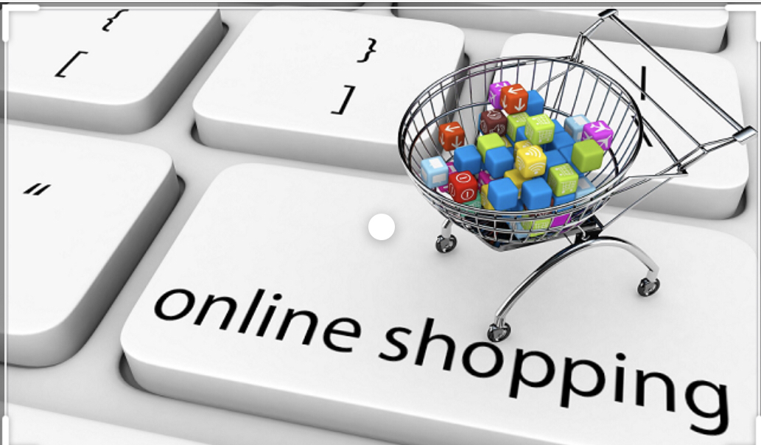
Benefits Of Online Marketing
A key benefit of using online channels for marketing a business or product is the ability to measure the impact of any given channel, as well as how visitors acquired through different channels interact with a website or landing page experience. Of the visitors that convert into paying customers, further analysis can be done to determine which channels are most effective at acquiring valuable customers.

Slide 7

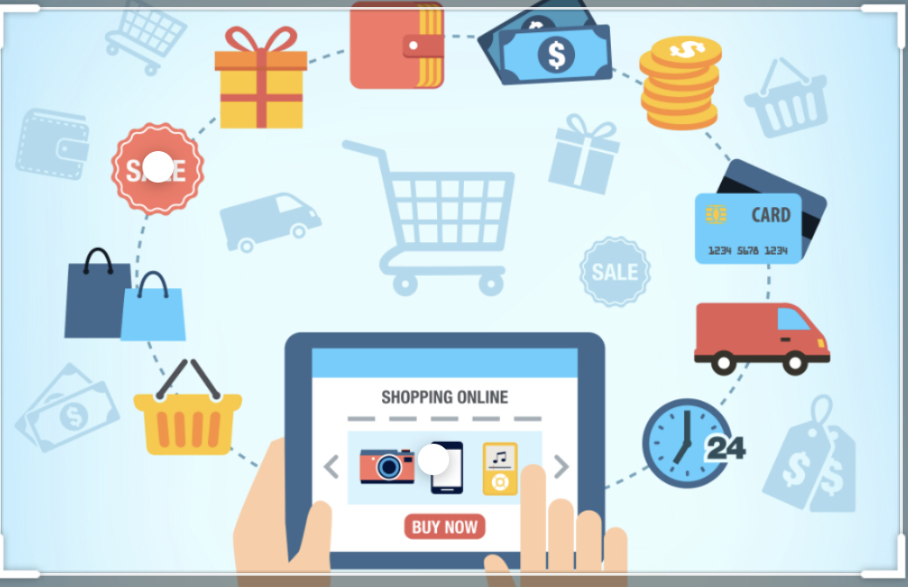
A complex marketplace with a vast functionality may cost up to $180K. The development of a mobile app for one platform (either Android or iOS) will take about 400 hours and will approximately cost $60K. The figures can also vary depending upon the complexity of a

